Slide 1



Build Interactive Web App with R & Shiny
Prepared by : Aep Hidayatuloh
Email : aephidayatuloh.mail@gmail.com
GitHub : https://github.com/aephidayatuloh
RPubs : https://rpubs.com/aephidayatuloh

Slide 2

Syllabus
Pertemuan | Kompetensi Dasar | Materi
5 | Mampu membuat tampilan dan input interaktif dengan pop-up | Menggunakan package {shinyalert} untuk dialog pop-up
 |  | Pengenalan package {shinyalert} untuk dialog pop-up
 |  | Pengunaan {shinyalert} untuk dialog pop-up
 | Mengenal Asynchronous program untuk shiny menggunakan package {promises} | Pengenalan Asynchronous program di aplikasi shiny
 |  | Penggunaan package {promises} untuk asynchronous program di shiny
 | Presentasi rencana tugas akhir | Presentasi rencana tugas akhir

Slide 3
Notification

Slide 4
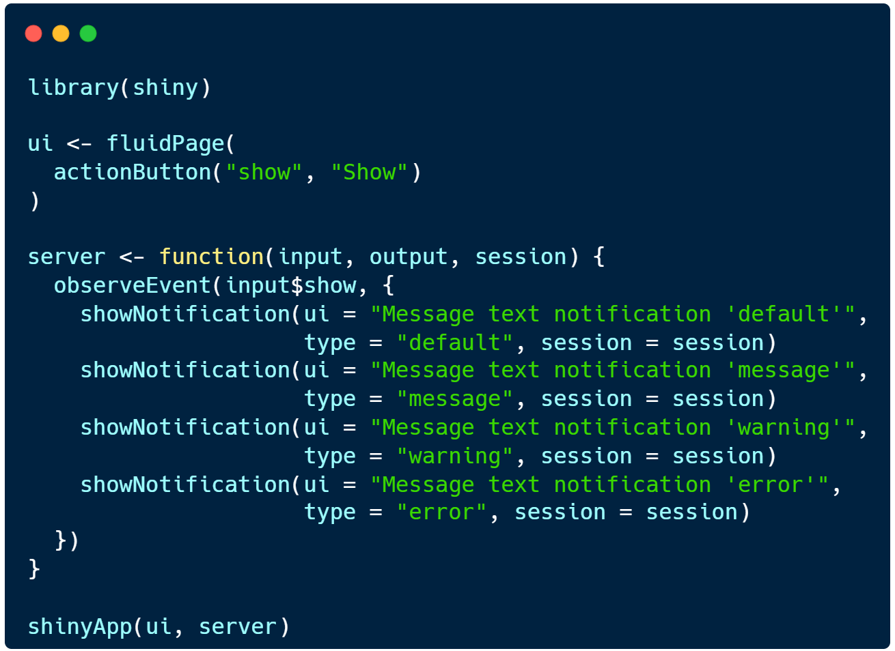
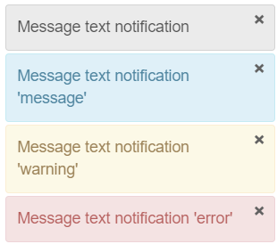
Notification
showNotification(ui, action = NULL, duration = 5, closeButton = TRUE, id = NULL,
type = c("default", "message", "warning", "error"),
session = getDefaultReactiveDomain())

Slide 5
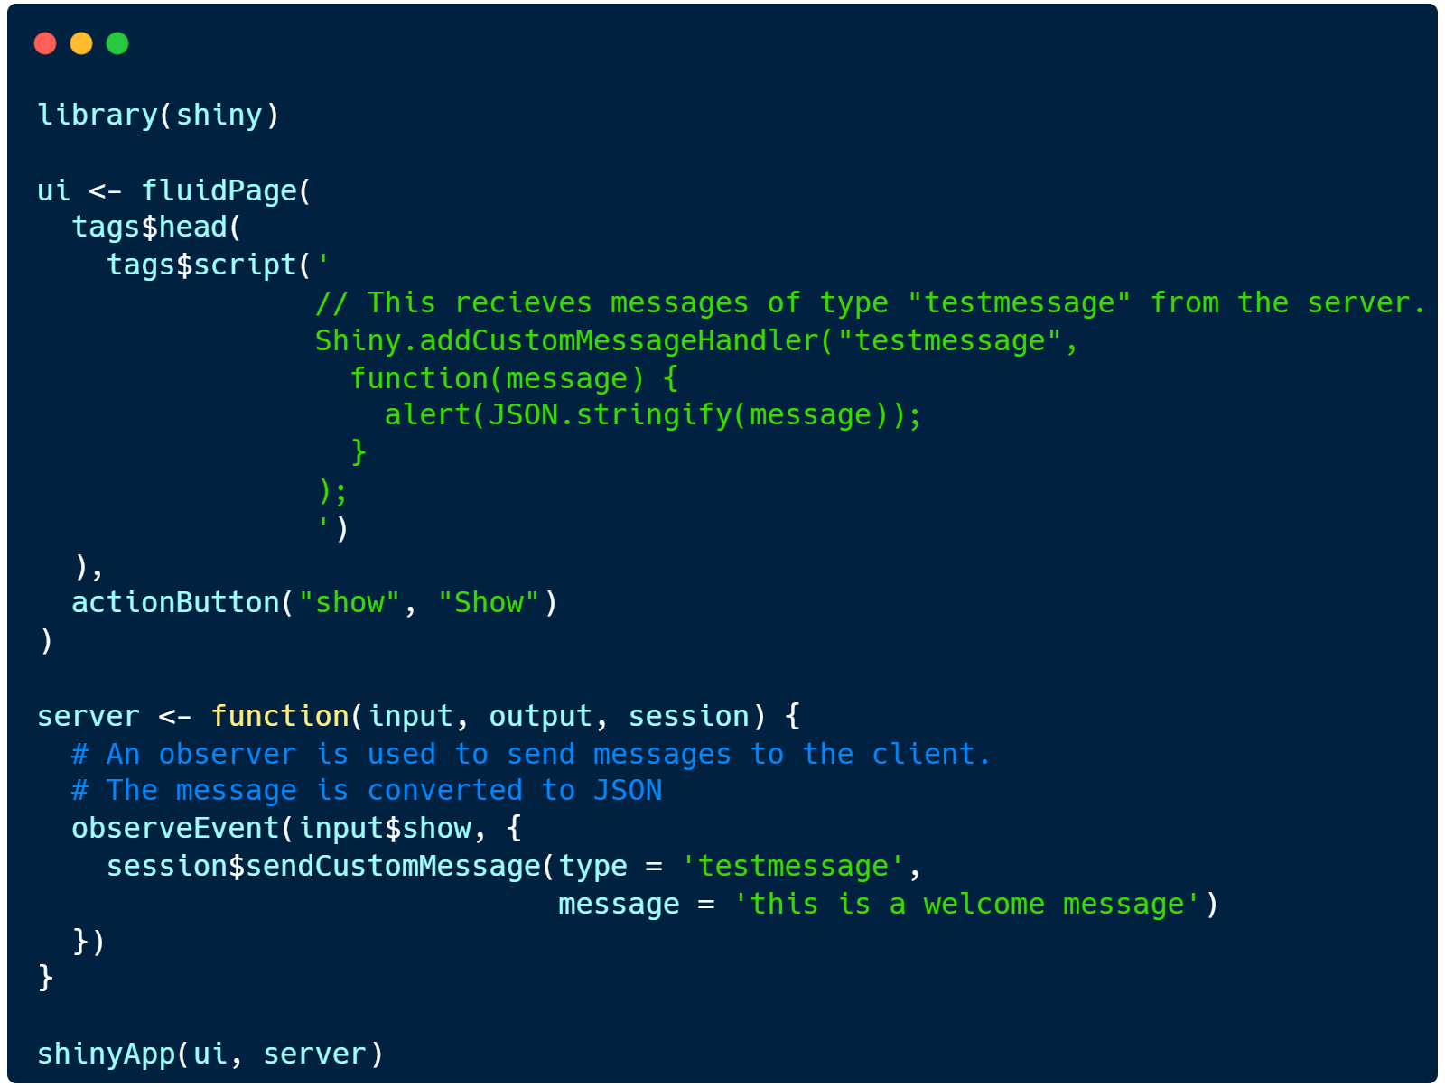
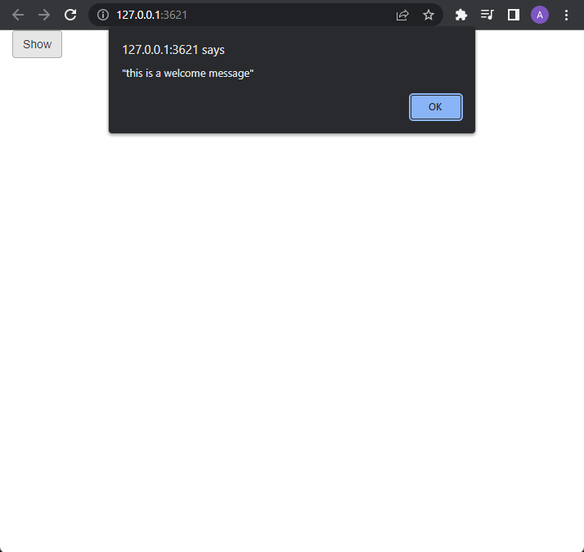
Server-to-Client Message
showNotification(ui, action = NULL, duration = 5, closeButton = TRUE, id = NULL,
type = c("default", "message", "warning", "error"),
session = getDefaultReactiveDomain())

Slide 6
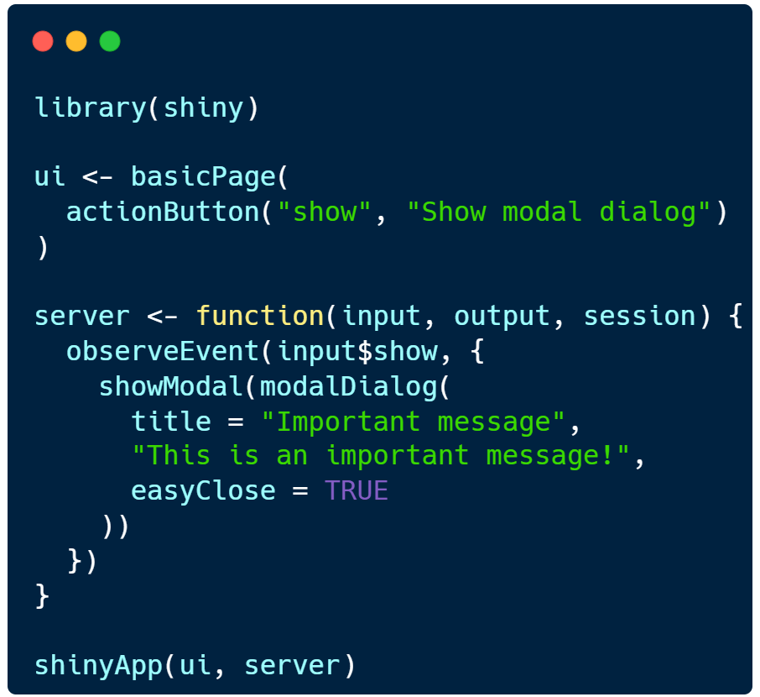
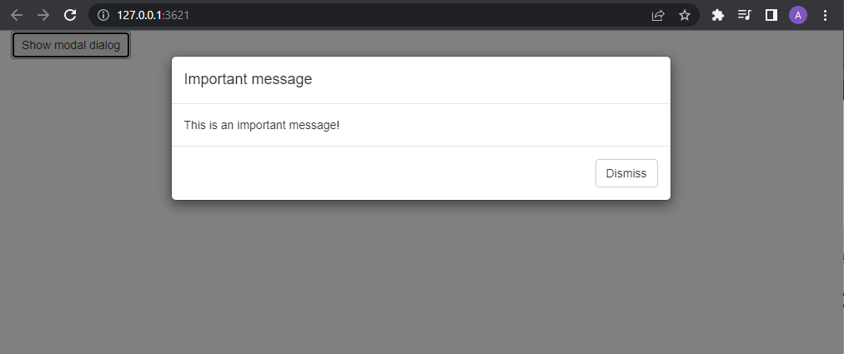
Modal Dialog
showModal(ui, session = getDefaultReactiveDomain())
modalDialog(…, title = NULL, footer = modalButton("Dismiss"),
size = c("m", "s", "l", "xl"), easyclose = FALSE,
fade = TRUE)
modalButton(label, icon = NULL)

Slide 7
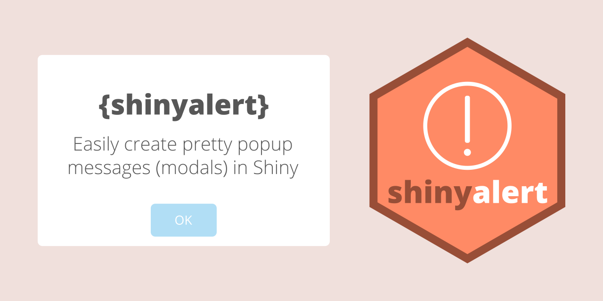
Modal Dialog {shinyalert}

Slide 8
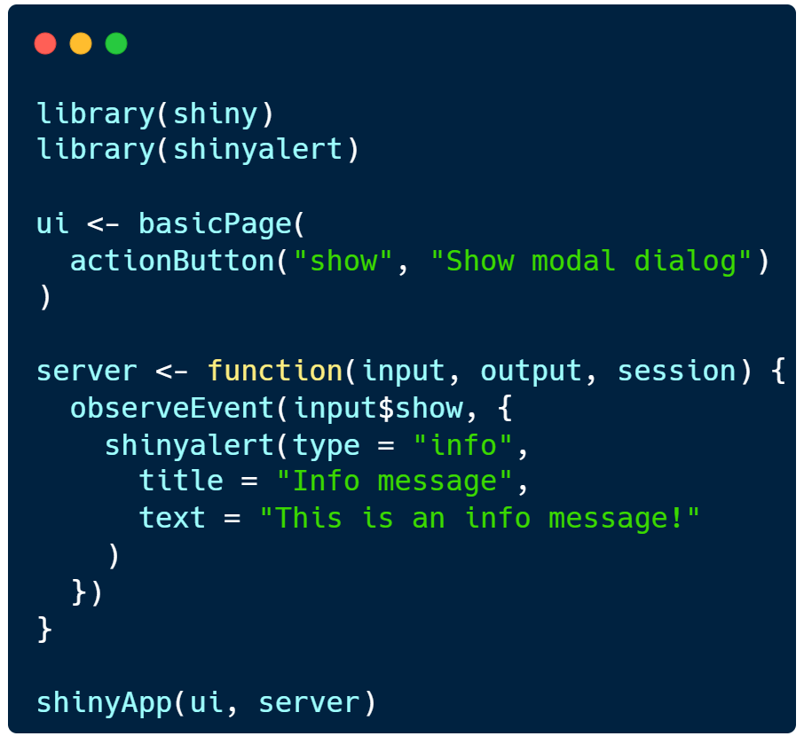
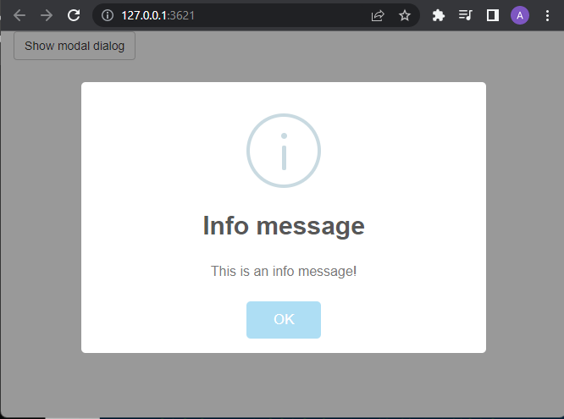
Modal Dialog {shinyalert}
Use ?shinyalert::shinyalert() to show the help and example

Slide 9
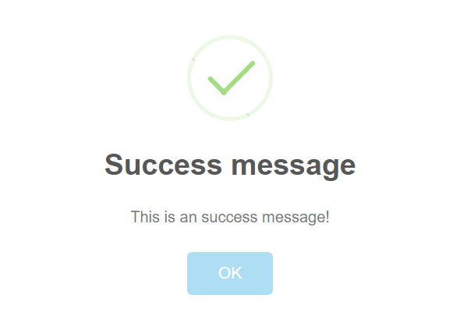
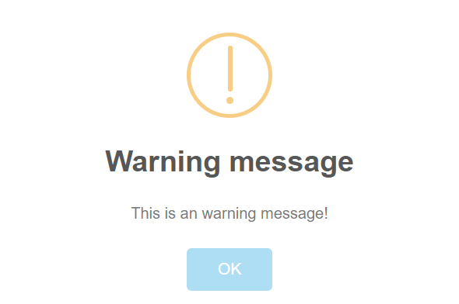
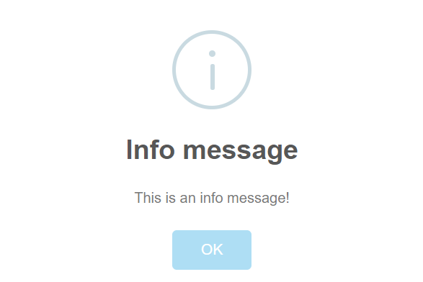
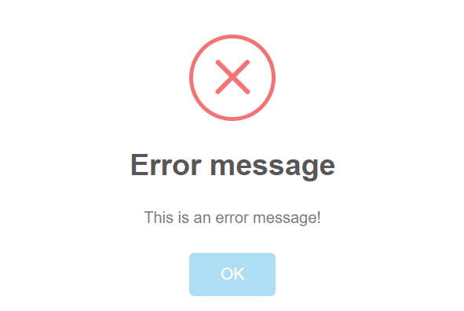
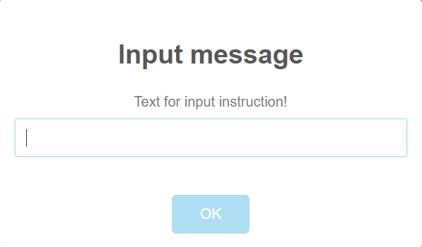
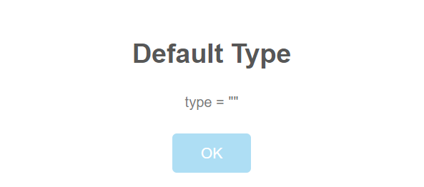
{shinyalert} Type
type = "success"
type = "warning"
type = "info"
type = "error"
type = "input"
type = "" (default)

Slide 10
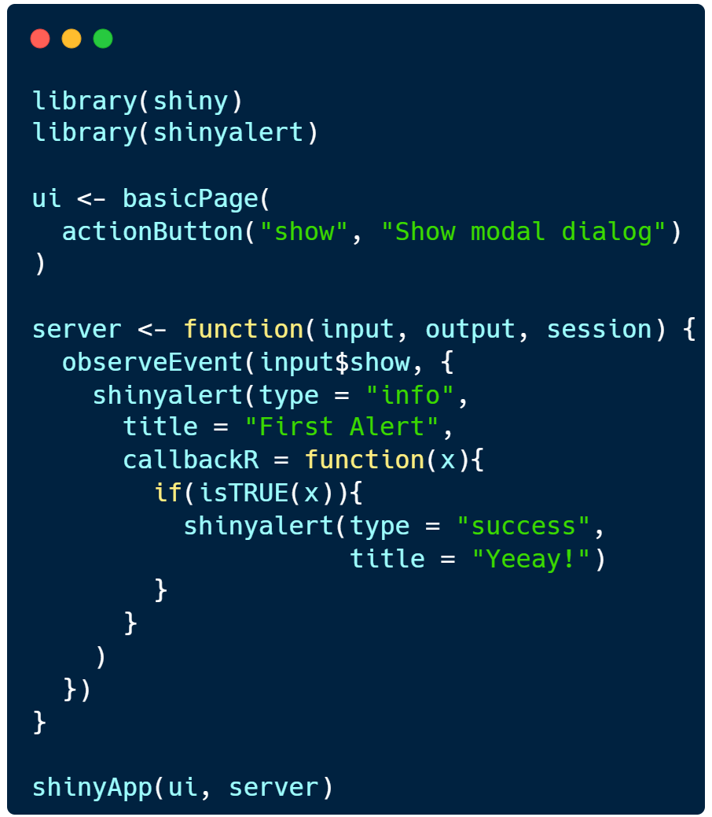
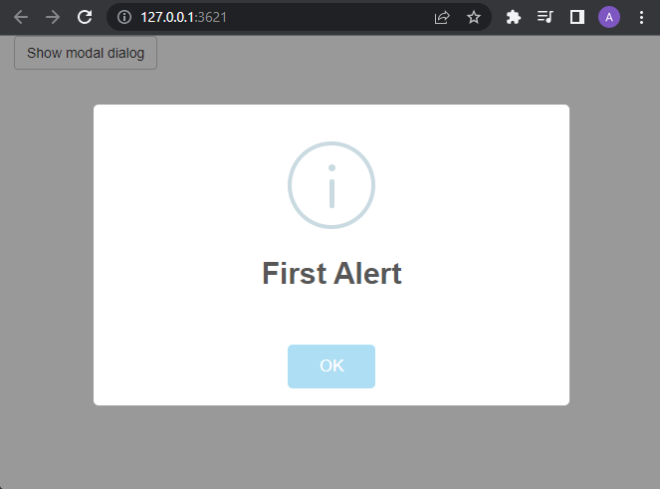
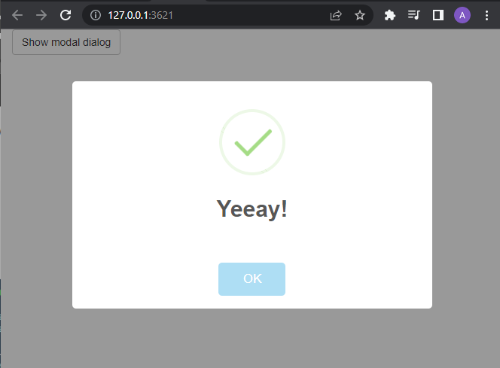
{shinyalert} after {shinyalert}
Use callbackJS if you want to use JavaScript

Slide 11
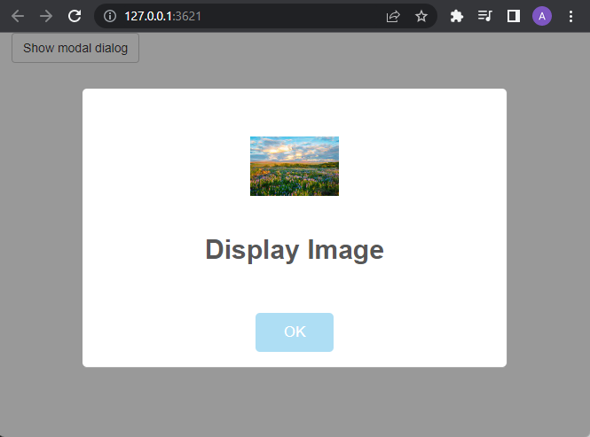
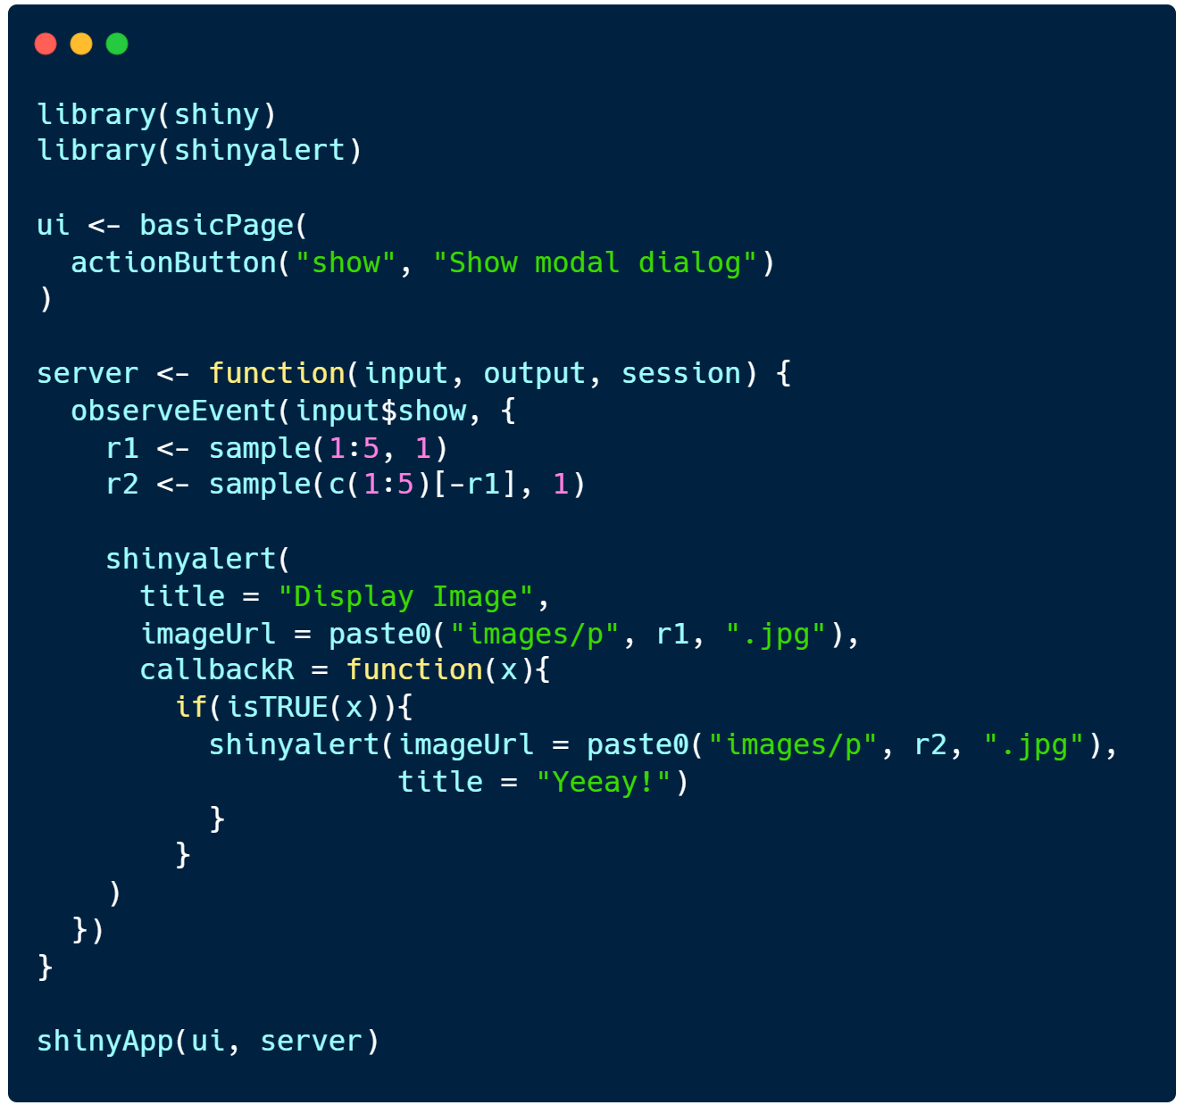
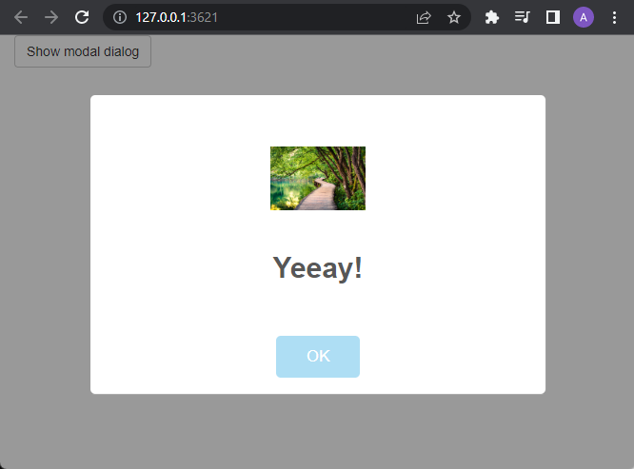
Image in {shinyalert}

Slide 12
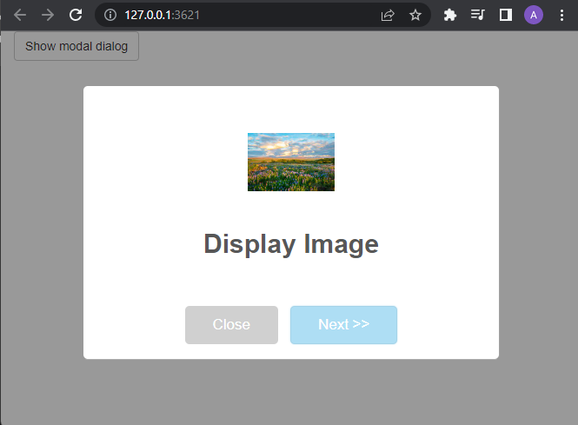
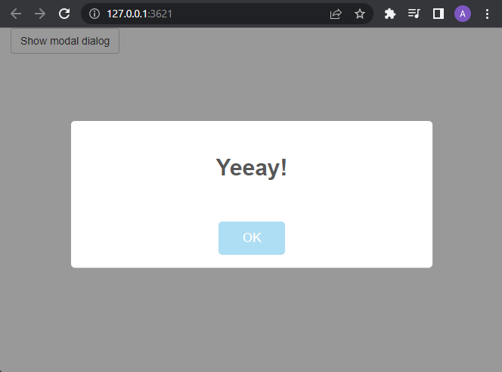
Choice in {shinyalert}

